Slide 1


Budget Line-Item Amendments
Building Efficiency, Compliance, Scalability, & Consolidation
Grant Seeker

Slide 2
Agenda
Launch Date & Overview of Changes
In-Product Demo Entering Amendment Scenarios
Reference Materials
Q&A

Slide 3
Launch & Overview
Launch date
Overview of Changes:
Budget category type amendment removed and replaced with Budget
Amendment history viewable on amendment details page
Summary of changes required for budget amendments
Grant Seekers can now save an amendment as a draft
Finalized budget amendment changes are automatically applied to the budget
10/24

Slide 4
Submitting or entering Amendment

Slide 5
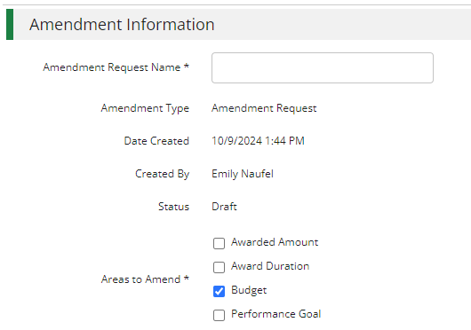
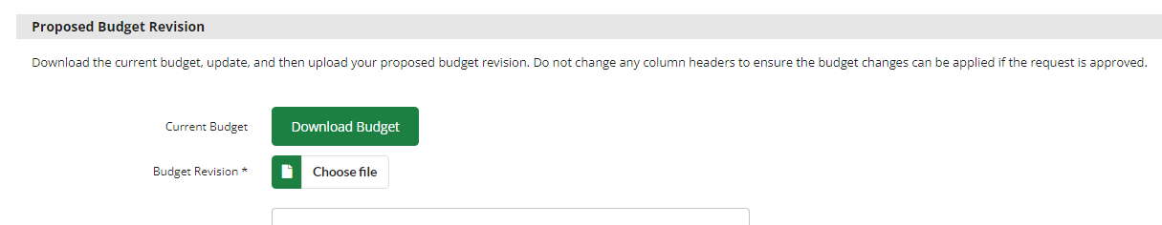
Select budget & download budget

Slide 6
Edit Excel file
To add a line item include a Category, Line Item name, Line Item Type and Total Budgeted (Direct Cost) at a minimum (include match or other more granular budget details as required)
To remove a line item delete the line item from the file
To change total budgeted for a line item update the Total Budgeted (Direct Cost)
To add, remove of change match update the Match Value columns

Slide 7
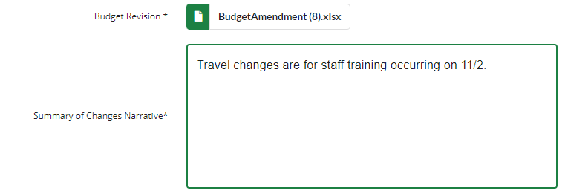
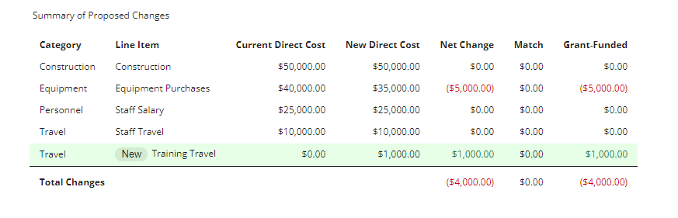
Upload excel file & review changes

Slide 8
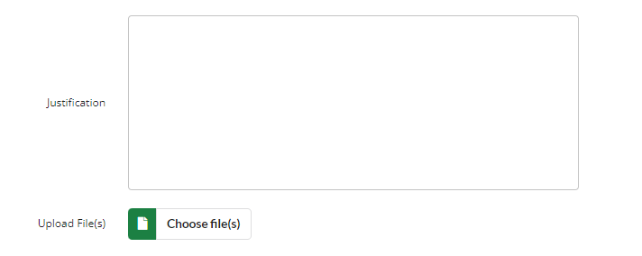

Add additional detail & Save or finalize

Slide 9
In-product Example
Entering an amendment with grant funded & match

Slide 10
In-product Example
Entering an amendment with purpose areas & direct cost calculation

Slide 11
Resources available on AmpliFund Support Site
Session recording
Editable session deck
Quick instruction guide
FAQ document

