Slide 1


Budget Line-Item Amendments
Building Efficiency, Compliance, Scalability, & Consolidation
Grant Maker

Slide 2
Agenda
Launch Date & Overview of Changes
In-Product Demo Submitting / Entering Amendment Scenarios
In-Product Demo Approving / Rejecting Amendment Scenarios
Reference Materials
Q&A

Slide 3
Launch & Overview
Launch date
Overview of Changes:
Budget category type amendment removed and replaced with Budget
Denied Amendments can be re-submitted
Amendment history viewable on amendment details page
Summary of changes required for budget amendments
Grant Seekers can now save an amendment as a draft
Approved or Finalized budget amendment changes are automatically applied to the budget
10/24

Slide 4
Submitting or entering Amendment

Slide 5
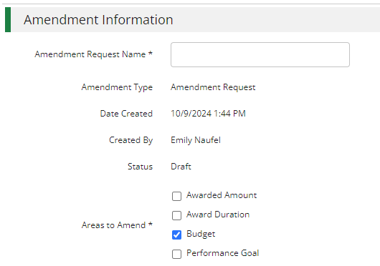
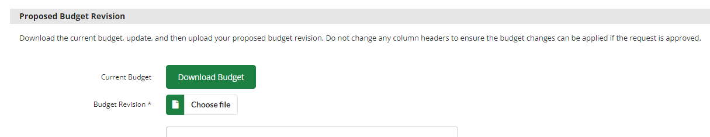
Select budget & download budget

Slide 6
Edit Excel file
To add a line item include a Category, Line Item name, Line Item Type and Total Budgeted (Direct Cost) at a minimum (include match or other more granular budget details as required)
To remove a line item delete the line item from the file
To change total budgeted for a line item update the Total Budgeted (Direct Cost)
To add, remove of change match update the Match Value columns

Slide 7
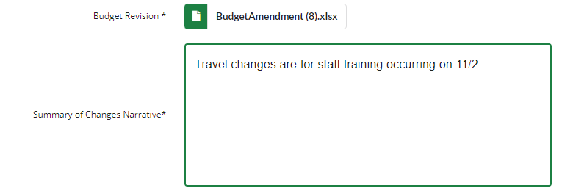
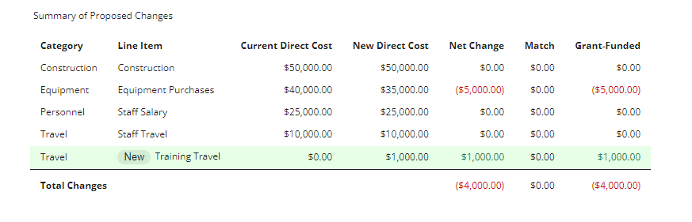
Upload excel file & review changes

Slide 8
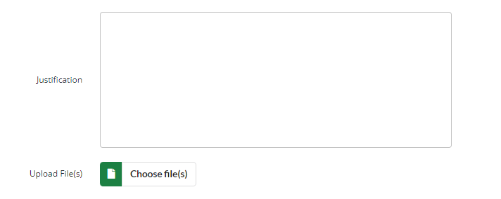


Add additional detail & Save or submit/finalize
Recipient view
Amendment entered by funder

Slide 9
In-product Example
Submitting an amendment with grant funded only

Slide 10
Rejecting / resubmitting an amendment

Slide 11
In-product Example
Re-Submitting a Rejected Amendment

Slide 12



Approving budget line-item amendment

Slide 13
In-product Example
Approved Amendment

Slide 14
Resources
Session is recorded & will be on support site
Editable session deck will be on support site
Quick instruction guide for recipients
FAQ document

