Slide 1
Build a Workflow With Me
June 2025

Slide 2

Today’s Session
Follow along with me and build your own workflow in AmpliFund
Log into AmpliFund
Use the Chat or Q&A button on Zoom to ask questions

Slide 3

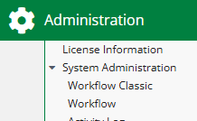
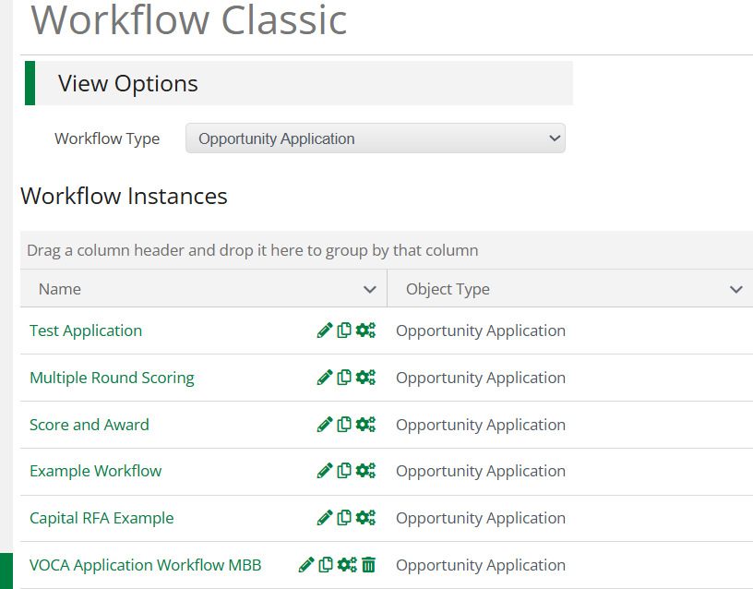
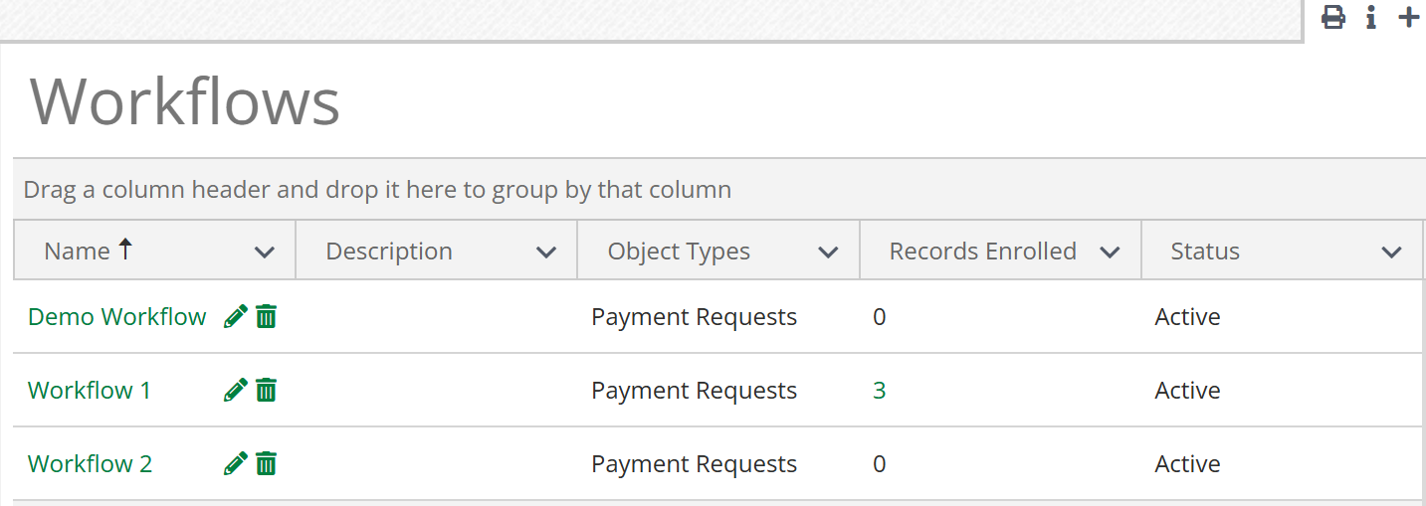
Key Changes
Classic
The new workflow engine has been created as a new sub-menu: Workflow. Previous sub-menu has been renamed Workflow Classic.
Payment Requests can be enrolled and routed through a Workflow for review.
Workflow Queues have been removed.
Ability to assign default assignees by user, role (such as Manager or Additional user) and department.
Payment Requests can be Approved or Rejected through Workflow Automation.
New

Slide 4
Other Future Releases within Workflow
Activity > Workflow Actions
  Available 5/30
Other Supporting Materials
Available on Zen Desk under the Upcoming Training and Videos tile and the FAQ & Best Practices tile
  Trainings
  Product Guide
  FAQ
  Short Videos
Reach out to your Customer Success Representative
Additional Objects to enroll, including Amendments, Payment Authorizations, and Awards
  Available 6/30
Reporting Categories
  Available 6/30
Required Field Validation
  By 7/4

Slide 5
New Workflow Engine

Slide 6
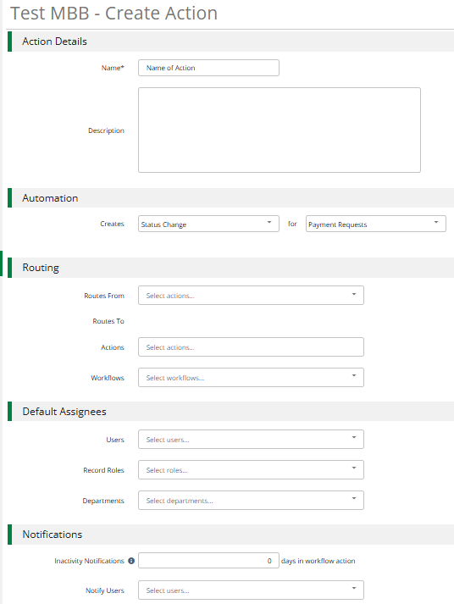
Name and Description of our Action.
Set up the Status Change for your Object/Payment Request.
Build the Routing Steps and Actions.
Select Assignees by User, Record Roles, and Departments.
Optional – Set up Inactivity Notifications for certain users.

Slide 7
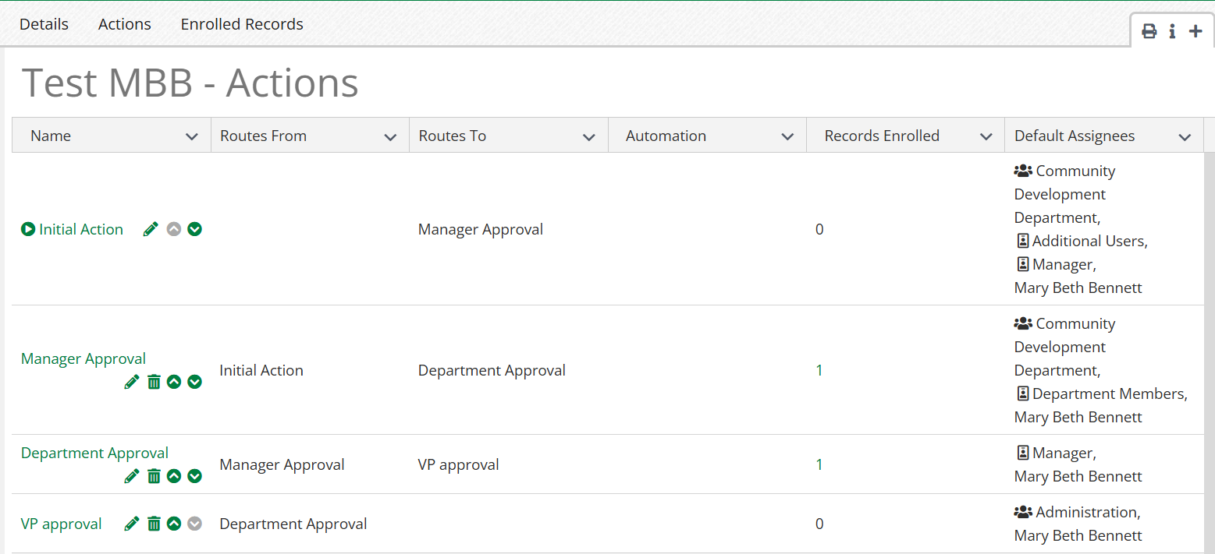
Actions Configuration

Slide 8
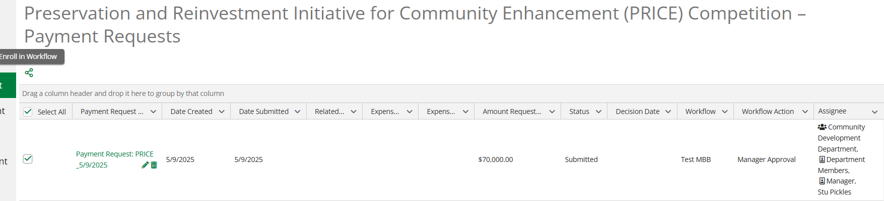
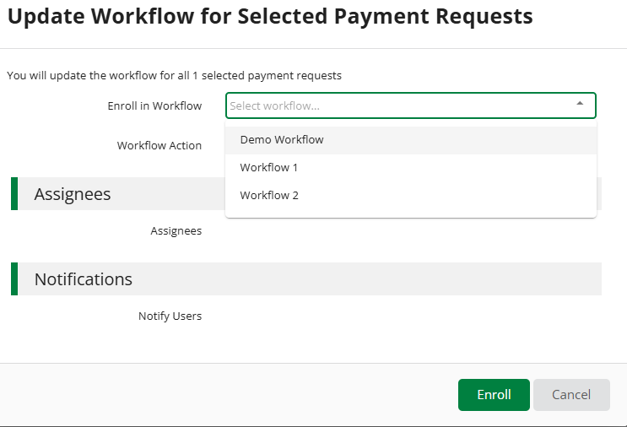
Enrolling in a Workflow

Slide 9
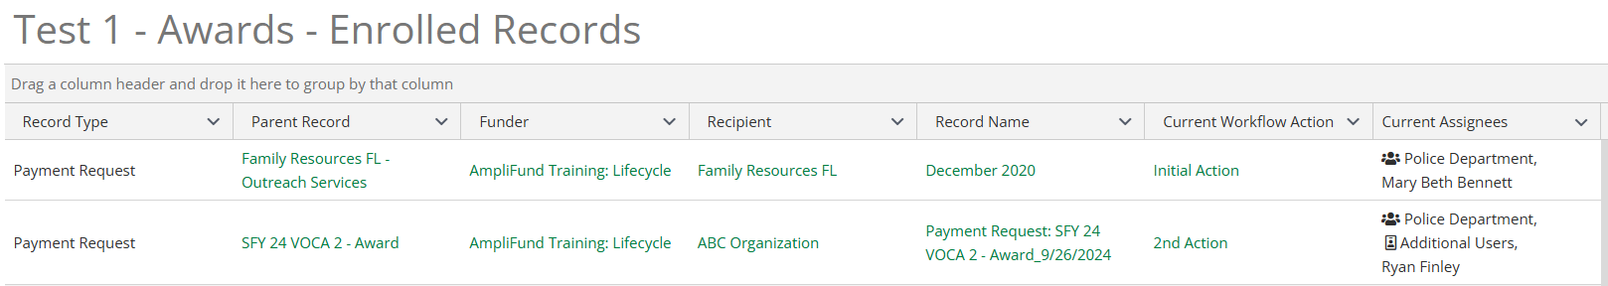
Actions with Enrolled Payment Requests

Slide 10
Ask Me Anything

