Slide 1



Applicant
Training

Slide 2
Agenda
Welcome & Introductions
Getting ready to register on the Euna Grants Applicant Portal
Applicant Portal Demonstration
  Navigation Overview
  Opportunity Review
  Application Process Review
  Administration Section
Q&A

Slide 3
Supported Browsers
Google Chrome (current supported releases)
Mozilla Firefox (current supported releases)
Microsoft Edge (current supported releases)
Apple Safari 10+

Slide 4
User Registration Basics
User registration is required to:
  Save an opportunity
  Apply for an opportunity
Information you’ll need to register:
  Email address
  Contact information
  Organization contact information
What happens next?
  Accept the terms & conditions then you’ll have full access to the applicant portal
To enable collaboration across your organization one user should set up the organization and invite users

Slide 5
Applicant Portal Demonstration

Slide 6
Q&A

Slide 7
Applicant Video Resources
Applicant Portal: New User Registration
Applicant Portal: Applicant Portal Navigation
Applicant Portal: Opportunity Overview
Applicant Portal: How to complete an application
Applicant Portal: How to complete a budget template
Applicant Portal: How to complete a performance plan template
Applicant Portal: Applicant Portal Administration Section
Applicant Portal: Application Status - View, Withdraw, Delete
Applicant Portal: Returning to the Applicant Portal
Applicant Portal: Application Revision

Slide 8
Key Administration Section Features
View applications
Update account information
Add users
Access FAQ

Slide 9





Key Steps to complete an application
Click
Complete Project Information
Complete Application form(s)
Complete Budget template
Mark each section as Complete
Review & Download Application (if desired)
Click Submit
=

Slide 10
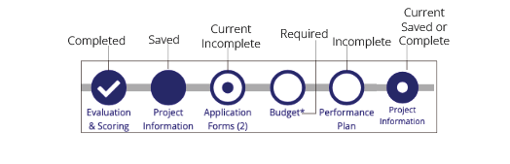
Application Progress Bar

Slide 11

Application Tips
You can complete the application sections in any order
Click on the circle of a section to navigate to that section
You must hit Save or Mark as Complete to save your work
If you’ve marked a section as “Mark as Complete” you can go back and edit that section by hitting “Mark as in Progress”
Every section must be marked as complete to submit your application
Submitted applications cannot be edited, you may withdraw but would need to complete a new application

Slide 12
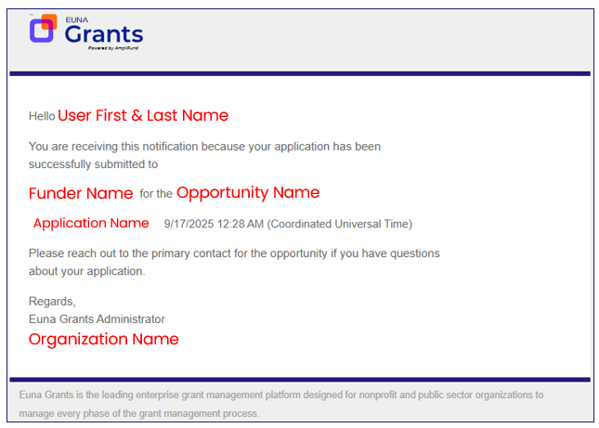
Application Submitted email confirmation

