Slide 1



Euna Grants Recipient Training

Slide 2
Agenda
Welcome & Introductions
Getting Started with Euna Grants
Euna Grants Navigation & Account Overview
Accessing Grant & Updating Budget
Tasks to Complete
Expense Entry & Payment Request Submission
Performance Achievement & Performance Reporting Period Submission
Amendment Request Submission
Available Reporting
Support Resources
Q&A

Slide 3
Supported Browsers
Google Chrome (current supported releases)
Mozilla Firefox (current supported releases)
Microsoft Edge (current supported releases)
Apple Safari 10+
For the best experience we encourage the use of Google Chrome

Slide 4
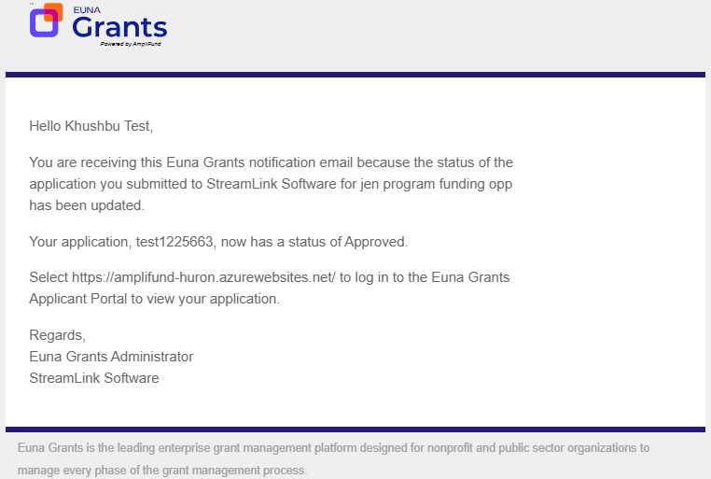
Award Activation
Account owner will use this link to set-up log-in and can add additional users.
https://www.gotomygrants.com
Award activation emails will be sent in the coming days

Slide 5
In Product Review

Slide 6
Summary of Required Actions
Administration: Log-in to Euna Grants & add relevant user to your account and invite them
Grant Management: Update the Recipient Manager
Activity: Enter Expenses
Post Award Management: Submit Payment Request
Activity: Mark Budget Reporting Period Task as Complete
Activity: Enter Performance Achievements
Post Award Management: Close Performance Reporting Period
As Needed:
Sync calendar with Euna Grants
Review available reports
Register on the Euna Grants Support Site

Slide 7
Support

Slide 8
Euna Grants Support
Submit a support ticket:
support@amplifund.zendesk.com
Visit the support portal:
https://amplifund.zendesk.com
Supported Browsers:
Google Chrome (current supported releases)
Mozilla Firefox (current supported releases)
Microsoft Edge (current supported releases)
Apple Safari 10+

Slide 9
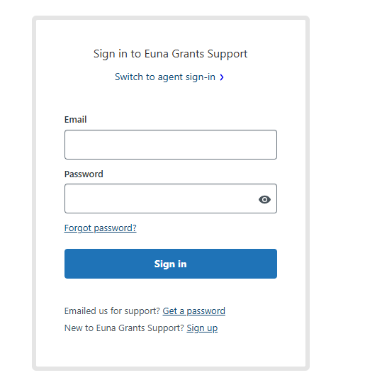
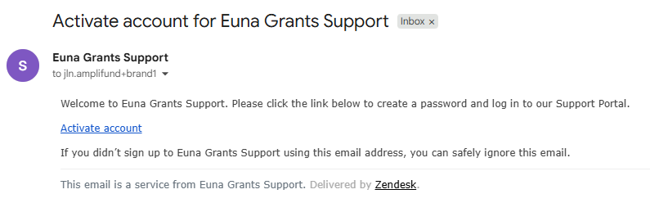
Euna Grants Support Site
Go to https://amplifund.zendesk.com
Click the Sign up link
Enter your full name
Enter your email address
Complete the I’m not a robot check
Click the Sign up button
A welcome email from support@zendesk.com will be sent to you via email
Click the link to set your password

Slide 10
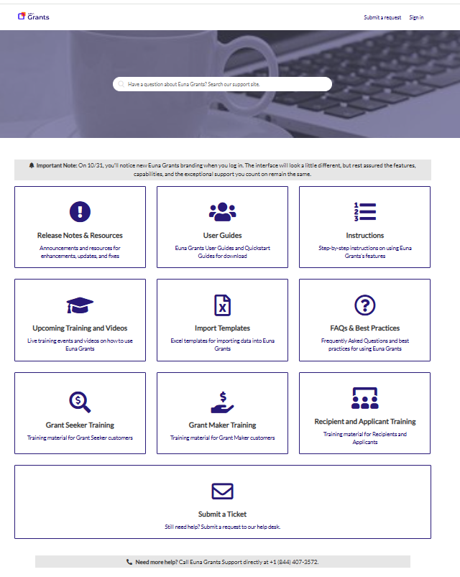
Welcome to Euna Grants Support

Slide 11
Thank you!

Slide 12
Appendix
Support Slides

Slide 13
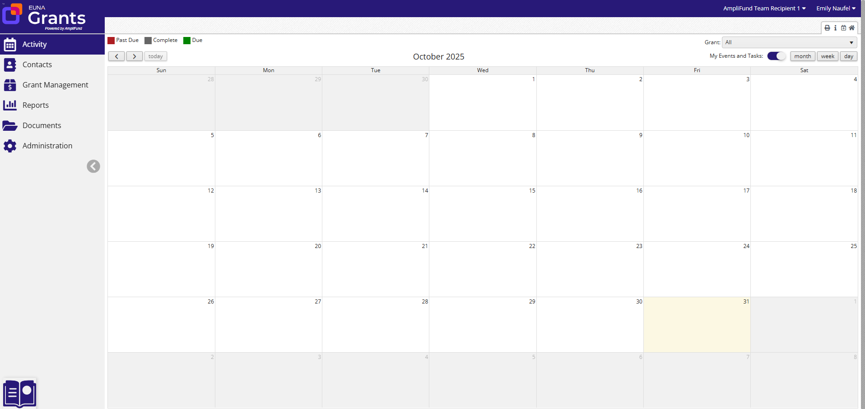
Navigating Euna Grants
2
3
1
Left Navigation -shows on every page
User Navigation –includes account information, change password, message center, support, terms and conditions, applicant portal, and logout
Options Toolbar –displays icons to perform functions available on the current page, icons vary based on page

Slide 14
Adding Users

Slide 15
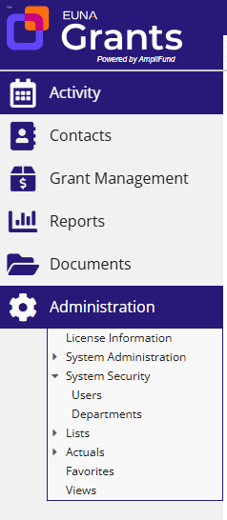

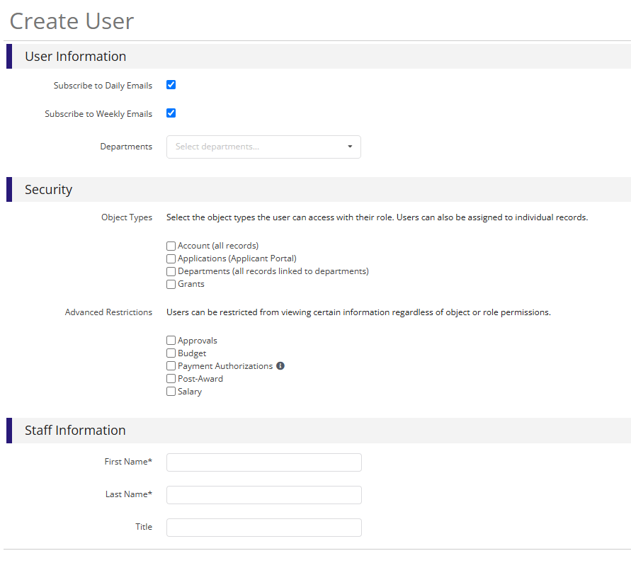

Creating Additional Users
Open Administration > System Security > Users
Click the + icon in the top right hand corner to create a User
Enter user preferences & information
  Select the User’s Email Preference
  User role
  User’s First Name, Last Name, and E-Mail Address
Click the ‘Create’ button
1
2
3
4

Slide 16
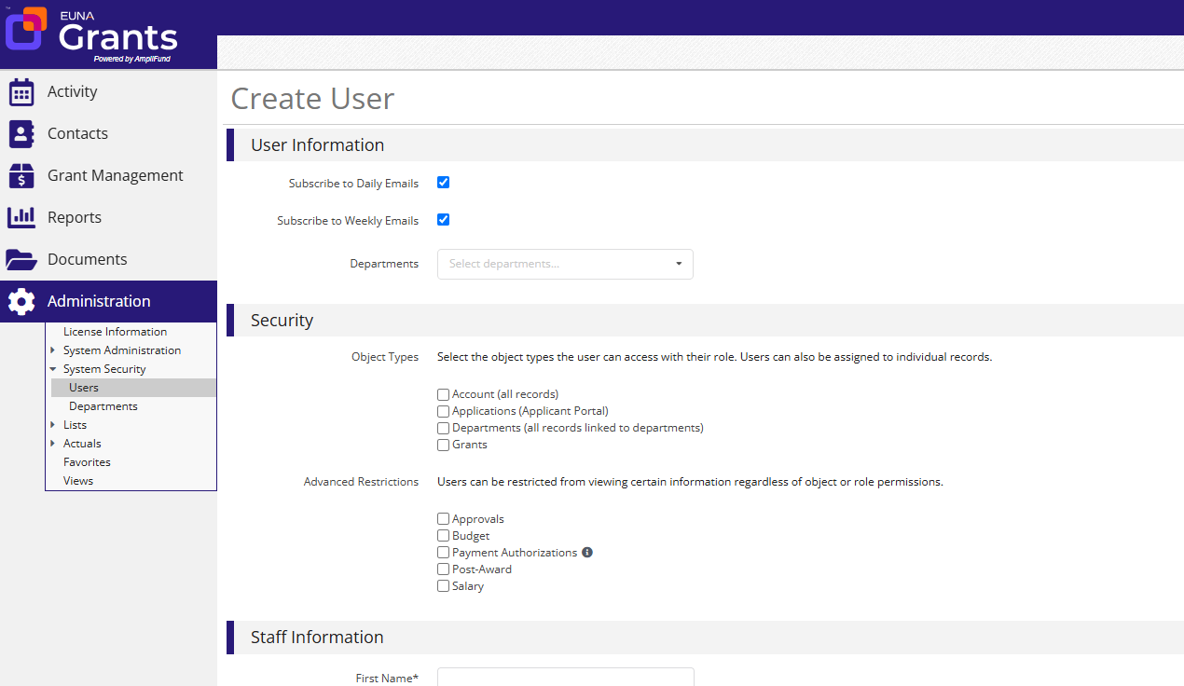
User Options
Subscribe to Daily/Weekly Emails
  Set to Yes to receive daily and/or weekly emails from Euna Grants with tasks/reminders
Applicant Portal Access
  Set to Yes to provide a user in your organization with access to submit applications
Object Types:
  Account, Applications, Departments or Grants
  Role:
  Admin, Editor, User, Viewer
  Advanced Restrictions:
  Approvals, Budget, Post-Award, Salary

Slide 17
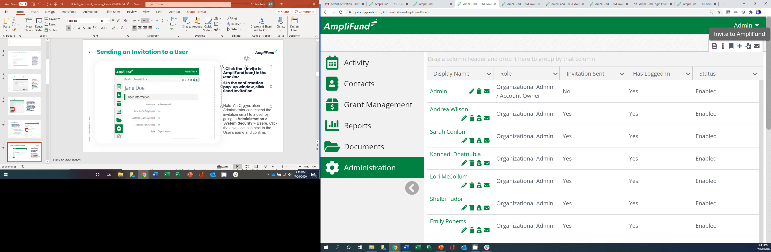

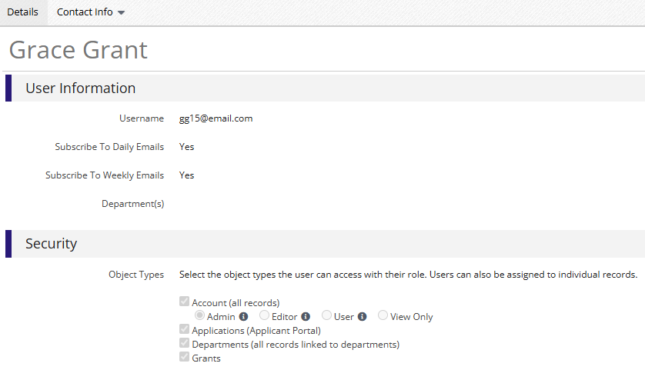
Sending an Invitation to a User
Click the in the Icon Bar
In the confirmation pop-up window, click Send Invitation
Link is active for 72 hours
Note: An Admin can resend the invitation email to a user by going to Administration > System Security > Users. Click the envelope icon next to the User’s name and confirm.

Slide 18
Updating Grant Award

Slide 19
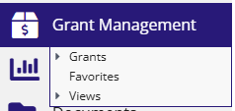

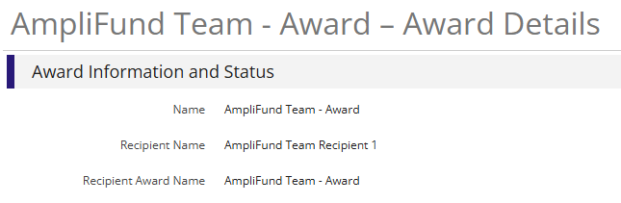
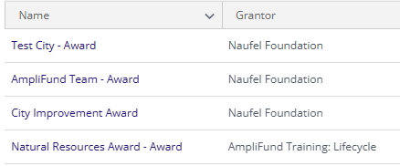
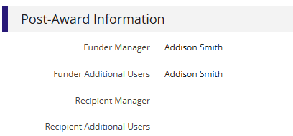

Updating Grant Award Details
Go to Grant Management > Grants
Click the grant name
Click the edit pencil in the upper right-hand corner
Update the Recipient Manager name, Add Recipient Additional Users (optional) & add Recipient award name (optional)
Click the Save button in the right corner of the screen
1
3
4
2
5

Slide 20
Accessing Budget

Slide 21
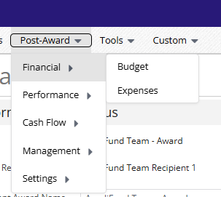
Accessing Budget
Go to Grant Management > Grants
Click the grant name
Click on Post Award>Financial>Budget
3
1
2

Slide 22
Expense Entry

Slide 23
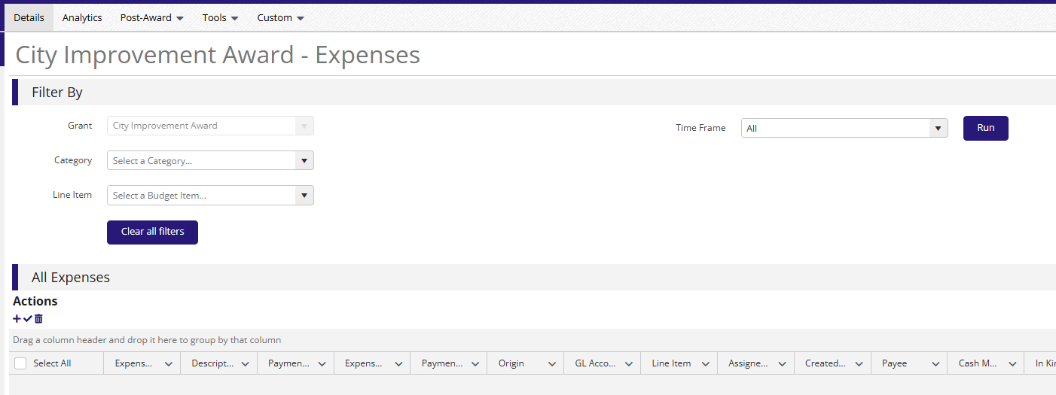
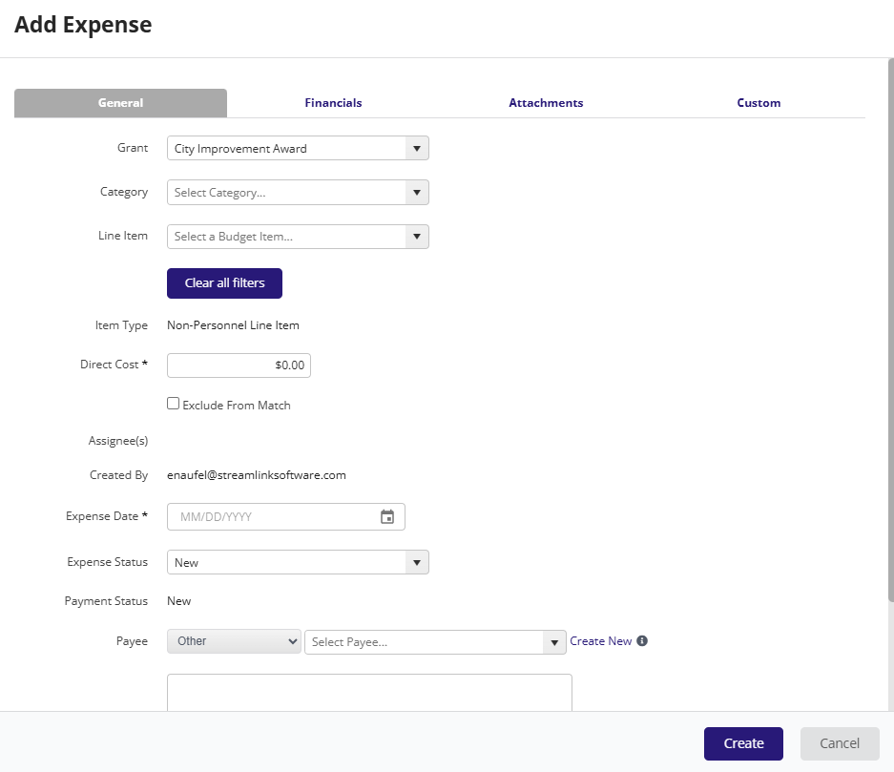
Expense Entry from Expense Module
From the Grant click on Post Award>Financial> Expenses
Click on the plus icon to add a new expense
Add expense information under expense tab then click Create
1
2
3

Slide 24
Submitting a Payment Request

Slide 25

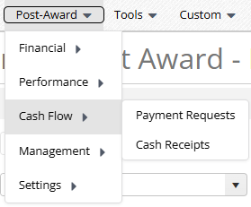
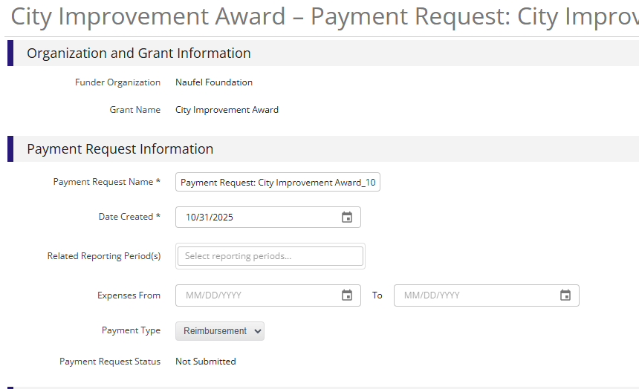
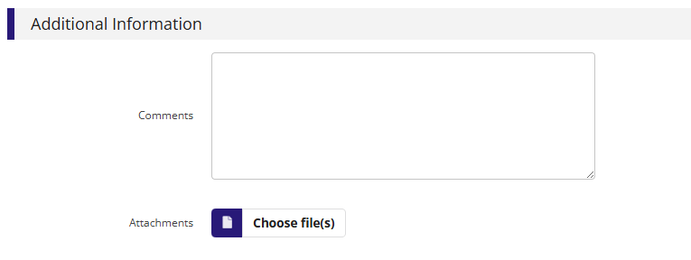


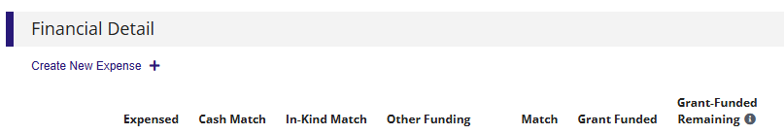
Generating a Payment Request
Post Award>Cash Flow>Payment Requests
Click on the plus icon to add a new request
Update relevant information and add expense from and to date
If desired add additional expenses
Type in total requested amount
Add any additional comments & upload files to Funder
Click submit to send to Funder
5
1
3
6
2
7
4

Slide 26
Creating & Submitting Performance Achievements

Slide 27
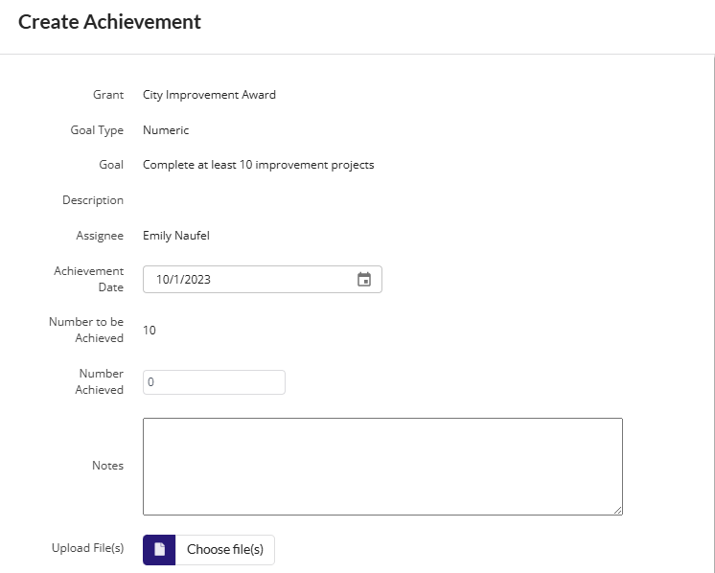
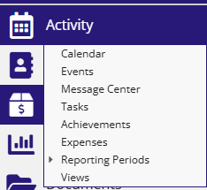
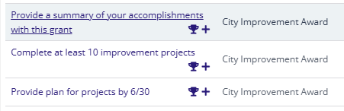

Creating Performance Achievements
Click on Activity then Achievements
Click on the plus icon next to the goal
Enter information about performance achievement
Click Create
Repeat for each relevant goal
3
1
2
4

Slide 28
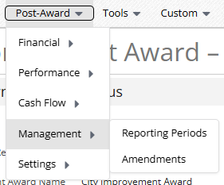

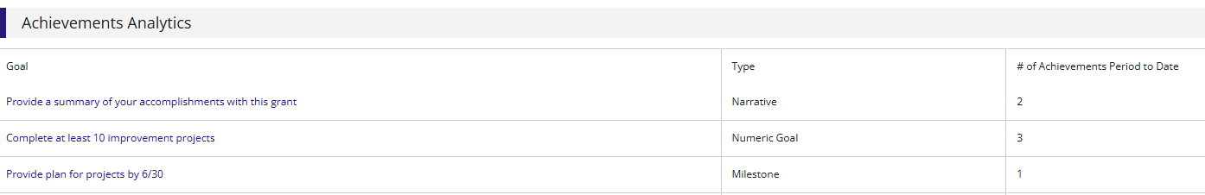
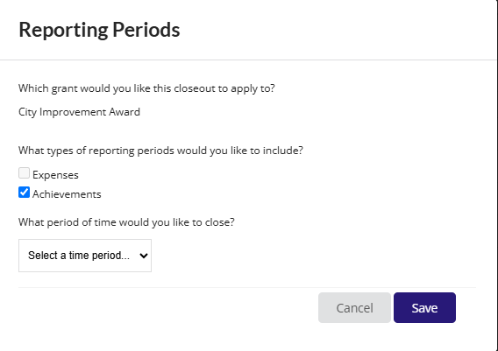

Generating a Performance Reporting Period
From the Grant click on Post Award>Management>Reporting Periods
Click on the plus icon in the upper right hand corner
Select Achievements and Time Period then click Save
Review achievements & details, click Close to send completed reporting period to Funder
4
1
2
3
5

Slide 29
Available Tools

Slide 30
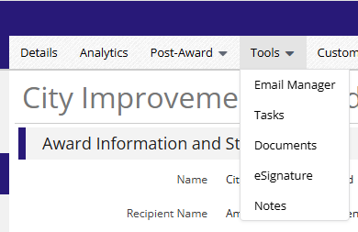
Available Tools
From Grant Record Select Tools

Slide 31
Available Reporting

Slide 32
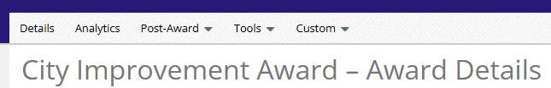
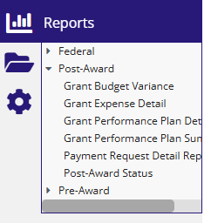
Available Reporting
Grant Dashboard
Other Reports

